Slide 1
Rotor Drive Tuning
Matt Fowler
6/23/2020

Slide 2
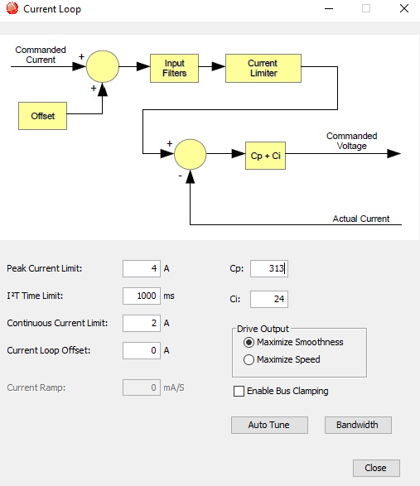
Initial Tuning
Initial tuning was performed without blades attached
Results in R32_I64_20210429_1244.ccx

Slide 3
Re-tuned
Auto Tune was performed with blades attached
Motor Position Wrap changed from “0” to “4096”
Saved as “R32_I64_20210623_1647.ccx”

Slide 4
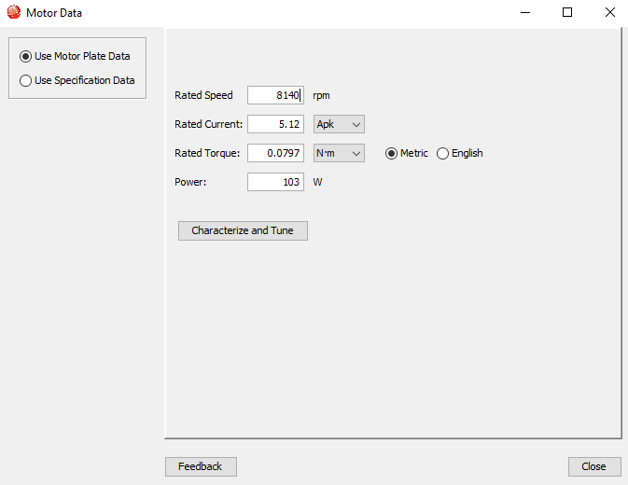
Motor Data
Rated Speed from datasheet
Kennlinie_cyber_d_32__5012-D027865-03 (2).pdf
Other values from previous tuning

Slide 5
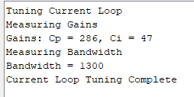
Current Loop Auto Tune

Slide 6
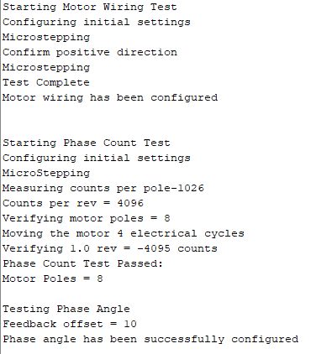
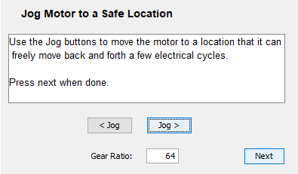
Auto Phase
Jog > yielded CW rotation looking downwind (positive rotation)

Slide 7
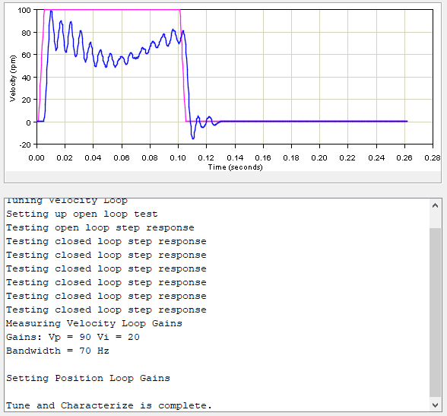
Velocity Loop Auto Tune

Slide 8
Manually detuned Velocity Loop
Try to reduce any amplification due to load from controller
Vp = 25, Vi=50

Slide 9
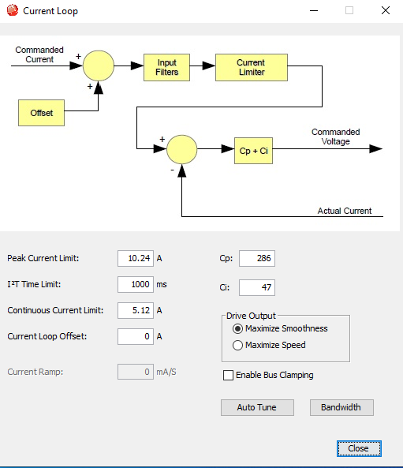
Retune, 9/14/2021
Cp = 286
Ci = 47

Slide 10
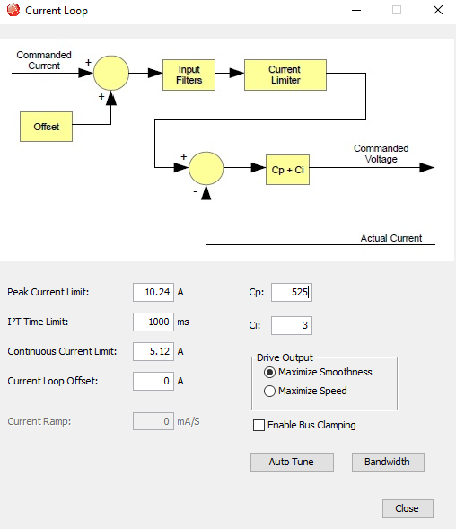
Labview Ctrl Tuning, 9/20/2021
Cp = 525
Ci = 3

